Slide 1

Tutorial 6: Exception Handling
COMP 249 CCCE
Object-Oriented Programming II

Slide 2
Tasks
Exception Handling

Slide 3
What is an exception?
Definition: An exception is an event, which occurs during the execution of a program, that disrupts the normal flow of the program's instructions.
Shorthand for the phrase "exceptional event“
Java uses a form of error trapping called exception handling to manage exceptional events that occur during the execution of the program
If this exception is not handled, it can cause the program to crash
Keywords:
Try: try block contains the code that could throw an exception
Catch: catch block gets executed when there is an exception in try block
Throw: throw keyword used to create a new exception object
Finally: finally block contains code that you want to always execute (it is optional)

Slide 4
Exception
Why we need an exception?
Checking the program can be time-consuming when testing
Deal with issues during runtime (invalid user input, file with wrong information, and network connection etc. )
User expect to handle those issues in a sensible manner
Your job as a programmer to anticipate problems that might occur during the execution and handle them
If certain operation cannot be executed due to an issue, the program should:
Return to safe state and let user continue program execution
Allow user to safe work and terminate

Slide 5
Try/Catch block
Multiple Exceptions:
try
{
code that might throw exceptions
}
catch (FileNotFoundException e)
{
emergency action for missing files
}
catch (UnknownHostException e)
{
emergency action for unknown hosts
}
catch (IOException e)
{
emergency action for all other I/O problems
}
try
{
//code
//more code
//more code
}
catch (ExceptionType e)
{
//handler for this type
}
*CodeExample:ExceptionHandlingExample

Slide 6
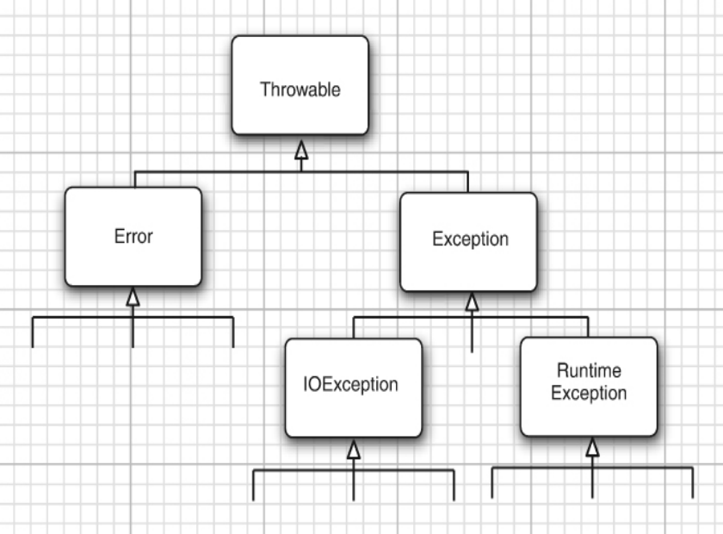


Exception Hierarchy
https://docs.oracle.com/javase/8/docs/api/java/lang/NumberFormatException.html
Exception Hierarchy in Java where all Exceptions are subclasses of Throwable
Throwable has two children : Error and Exception
Errors are internal errors inside Java runtime system
You should not catch object of type Throwable it is not a good practice that leads to unexpected behavior (you don’t want to catch errors)
Exception Hierarchy branches into IOException and Runtime Exception
Core Java Volume I: Fundamentals

Slide 7

Exception
Exception Hierarchy: IOException and RuntimeException
RuntimeException – “it is programmer’s fault” or programming error
RuntimeException inherited problems are:
Bad cast
Out-of-bounds array access
Null pointer access
Core Java Volume I: Fundamentals

Slide 8
Compile Time & Runtime
Compile Time – time when source code is converted into executable code; in Java the source code is translated into bytecode by Java Compiler (using javac)
Compiler checks for syntax and semantic (like wrong variable) errors
Runtime – time when the executable code is run; in Java compiled bytecode gets executed by Java Virtual Machine (JVM)
Runtime Errors could be division by zero, null pointer exception

Slide 9
Exception
Exceptional condition is a problem that prevents the continuation of the current method or scope. You cannot relegate the issue in the current context
When you throw an exception:
Exception Object is created on the heap (new keyword)
Path of execution is stopped & reference for exception object is ejected from current context
Exception-handling mechanism is in charge of searching for appropriate place, the exception handler, to continue
Exception handler recovers from the issue, it is like a guardian
Exceptions allow you to force the program to deal with the problem and return to a stable state or force the program to stop and tell the issue

Slide 10
Checked Exception
The compiler checks that you provide exception handlers for all checked exceptions.
Checked Exception – checked for at compile time
So if we don’t handle it, we will get a compilation error
Unchecked exception - are either beyond your control (Error) or result from conditions that you should not have allowed in the first place (RuntimeException)
Java Language Specification calls any exception that derives from the class Error or the class RuntimeException an unchecked exception. All other exceptions are called checked exceptions.

Slide 11
Throw an Exception
Throwing an exception means creating exception object and alerting the system that there was an unexpected event
We can send information about the error by creating an object representing your information and "throwing" it out of your current context
We throw an exception using throw keyword
Object has the type of exception (created using new keyword )
if(t == null)
throw new NullPointerException();
Here, reference that hasn’t been initialized, so you might want to check before trying to call a method using that object reference
*Code Example :ThrowingException

Slide 12
Finally
The code in the finally block executes no matter if of an exception was caught or not
There is a problem where code in finally block can overwrites the code from try or catch blocks
*CodeExample:ExceptionHandlingExample

Slide 13
When to Use Exceptions?
1. Handle problems at the appropriate level. (Avoid catching exceptions unless you know
what to do with them.)
2. Fix the problem and call the method that caused the exception again.
3. Patch things up and continue without retrying the method.
4. Calculate some alternative result instead of what the method was supposed to
produce.
5. Do whatever you can in the current context and rethrow the same exception to a
higher context.
6. Do whatever you can in the current context and throw a different exception to a higher
context.
7. Terminate the program.
8. Simplify. (If your exception scheme makes things more complicated, then it is painful
and annoying to use.)
9. Make your library and program safer. (This is a short-term investment for debugging,
and a long-term investment for application robustness.)

Slide 14
References
Core Java Volume I: Fundamentals 12th edition by Cay S.Horstmann
Thinking in Java 4th edition by Bruce Eckel
https://docs.oracle.com/javase/tutorial/essential/exceptions/definition.html

Slide 15
Have a Great Weekend and Happy Coding!

